Slide 1
NLP Project Analyzing therapy sessions
Model 1 Evaluation
Se22uari170-M.Susmitha
Se22uari067-K.Chandana Priya
Se22uari150-Sameera.N
Se22uari199-P.Sachethan

Slide 2
Motivation
We chose this project on analyzing therapy sessions using NLP because it merges our passion for technology with a meaningful application in mental health. We’re motivated by the potential to enhance therapeutic practices, ultimately improving client outcomes. This project allows us to explore how language and communication affect therapy, providing valuable insights that can help therapists refine their techniques. Additionally, the interdisciplinary nature of this work excites us—it’s a chance to collaborate with peers and professionals, expanding our skills and knowledge in both NLP and psychology. We believe that by leveraging technology in this way, we can contribute to a field that truly impacts lives, making our work not only educational but also fulfilling.

Slide 3
Problem Statement
Therapists encounter significant challenges in efficiently analyzing unstructured therapy session dialogues. The manual review and interpretation of these transcripts are time-consuming, subjective, and prone to oversight, making it difficult to track client progress, identify recurring themes, and detect crucial emotional or cognitive cues in real-time. This project aims to utilize Natural Language Processing (NLP) techniques to automate the analysis of therapy sessions, providing therapists with accurate, objective, and timely insights. By enhancing therapists' ability to deliver more effective, responsive, and personalized mental health interventions, this NLP-driven solution seeks to improve overall therapy quality and client outcomes."

Slide 4
Pipeline
Data Collection (Transcription): Convert recorded therapy sessions into text using speech-to-text tools.
Preprocessing:
Tokenization: Break down the text into words or sentences.
Stop Word Removal: Remove common but unimportant words (like "the", "is", etc.).
Stemming/Lemmatization: Reduce words to their base form (e.g., "running" becomes "run").
Emotion & Sentiment Detection: using sentiment detection tools to detect the emotional tone (positive, negative, or neutral).Apply emotion detection models to identify specific emotions like happiness, sadness, anger, etc.
Topic Extraction: Use topic modeling techniques to find recurring themes or topics (e.g., stress, anxiety, relationships).
Progress Tracking: Compare language patterns over multiple sessions to identify signs of improvement or recurring issues.
Visualization: Present findings in a dashboard or report with insights about emotional trends, progress, and key topics.
Data Privacy: Ensure all patient data is anonymized and secure to protect privacy. This simple pipeline gives therapists valuable insights without overwhelming them with technical details.

Slide 5
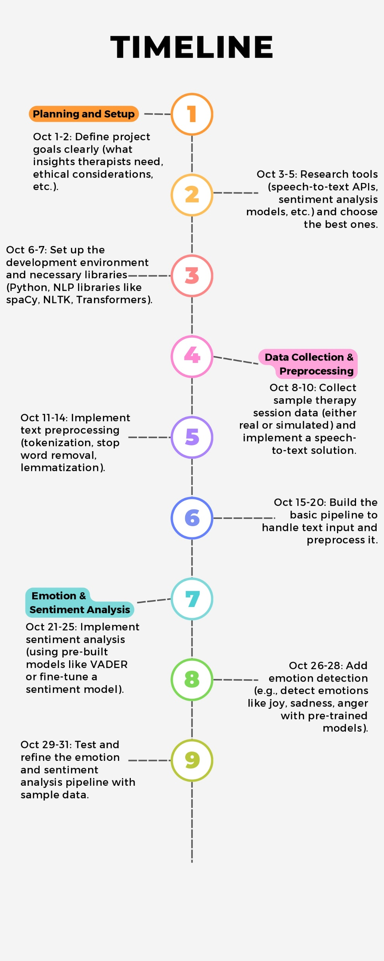

Slide 6
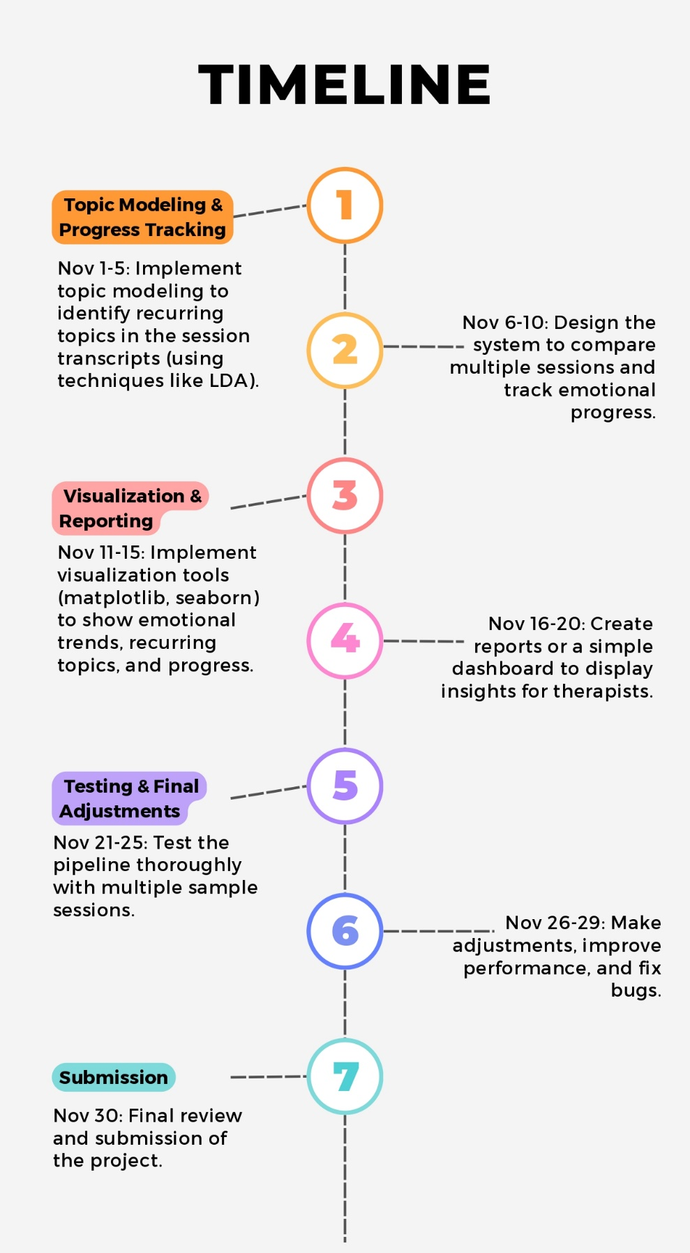

Slide 7
Expected Outcome
Emotion and Sentiment detection tools to find accurate identification of emotional patterns (e.g., joy, sadness, anxiety) in therapy session transcripts . Sentiment analysis to gauge the overall emotional tone of sessions (positive, negative, neutral).
Topic Modeling : Discovery of recurring themes or topics (e.g., stress, relationships, work-life balance) across multiple sessions .
Progress Tracking : Ability to track emotional and thematic changes over time, highlighting signs of improvement, recurring issues, or new concerns .
Actionable Insights for Therapists : Provide therapists with a data-driven summary of each session, including emotional highlights, key conversation topics, and overall session tone . Enable more personalized treatment adjustments based on the linguistic patterns detected .
Dashboard or Reports : Visual representation of emotional trends, client progress, and session summaries for easy therapist review.

Slide 8
Applications
Tracks clients' emotions over time to see if therapy is working.
Shows important topics or feelings that need more attention.
Helps therapists check if clients are improving or facing challenges through their words.
Gives an extra, objective view of progress to support the therapist's judgment.
Automatically processes session notes, saving therapists time.
Detects early signs of mental health issues so therapists can step in quickly.
Useful for researchers and students to study therapy and learn from language patterns.

